Slide 1
Predicting Party Membership in U.S. Politics
301-2 Final Project
John Lee

Slide 2
Research Question
(1) What explains support for political parties in the U.S. context?
In particular, I’ll focus on support for the Democratic Party
The focus here is on identifying statistically significant predictors (i.e., which predictors matter? And how much do they matter?)
(2) Overall (i.e., after accounting for the full set of predictors), how well can we predict support for political parties?
The focus here is on assessing the size of the test MSE

Slide 3
The dataset
General Social Survey (GSS)
The General Social Survey (GSS), which is run by the National Opinion Research Center (NORC) at the University of Chicago.
The GSS uses a stratified probability-based sampling method and asks a large number of questions related to social, cultural, political, and economic issues
Survey data is available from 1972-2016
Why GSS?
Biggest reason: they’ve asked the same questions for over 40+ years (so the questions/answers are relatively comparable across time)

Slide 4
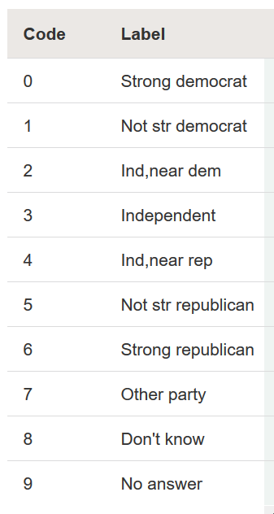
The DV:
Question from the survey:
“Generally speaking, do you usually think of yourself as a Republican, Democrat, Independent, or what?”
It was reverse coded on a 1-7 point scale
7 = “Strong democrat”
1 = “Strong republican”
Respondents choosing answers 7-9 were dropped

Slide 5
Data collection and cleaning
Dataset collection:
Goal: find all of the variables that had data between 1974-2016
Result:
Full sample: 62,466 observations
64 variables (including DV and year)
Data cleaning:
Filter in variables of interest (remove redundant predictors, predictors with a lot of missing data)
Rename predictor names (more intuitive names), set the correct var type (class)
Recode the values (e.g., sometimes needed to reverse code); this entailed creating custom functions
For the factor vars, explicitly set the reference categories
Final sample:
17,718 observations, 35 variables (including DV and year)

Slide 6
General Approach
Randomly split the final dataset into four parts (seed set to 3, per class norms):
(1) EDA: 25%
(2) Model-building: 25%
(3) Model validation: 25%
(4) Model testing: 25%
My approach:
(1) Perform EDA
(2) Select candidate models (i.e., the best model for each method)
Part 1: My models
Use my knowledge of the relevant literature and the EDA to come up with five “top” OLS models
Use the validation set approach to choose the best model (using validation/test MSE)
Part 2: Automated methods
Find the best model: Ridge, Lasso, PCR, PLS, Forward selection, Backward selection
Use k-fold CV (k = 10) to find the optimal tuning parameters (lambda, M)
(3) Compare the performance of the candidate models using the validation set – then choose a final model
(4) Test my final model using the held-out test set

Slide 7
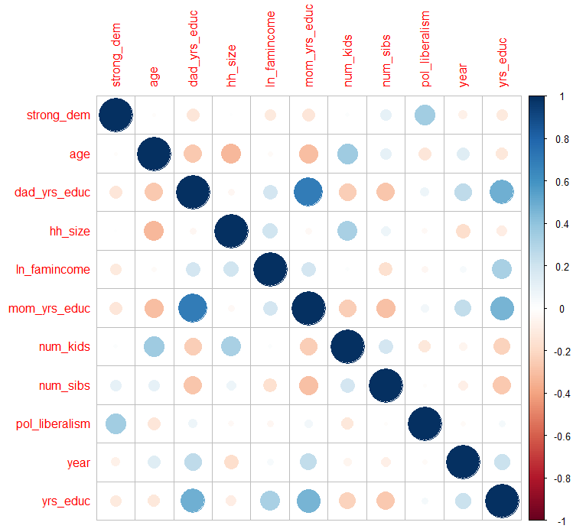
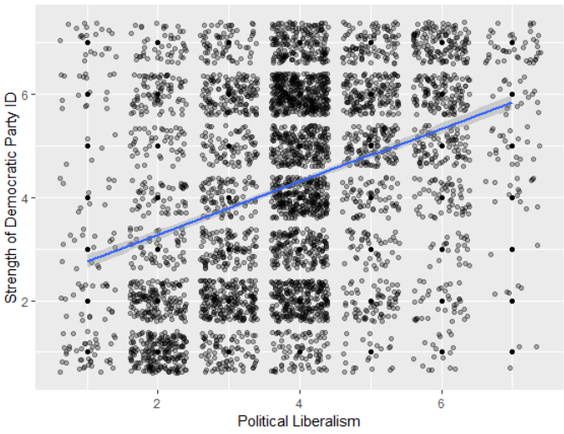
(1) EDA, Part 1 (Numeric Predictors)
Key finding: Most numeric/continuous variables are weak predictors of the DV. The exception is political liberalism, which makes sense

Slide 8
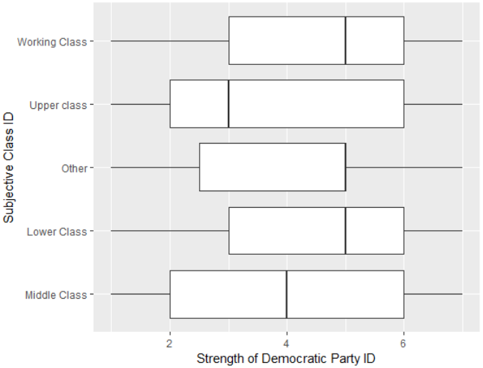
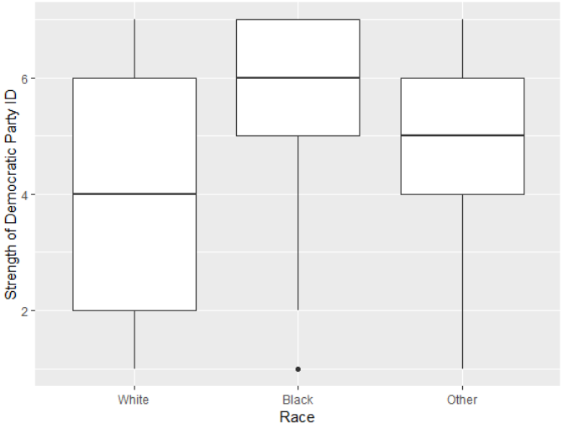
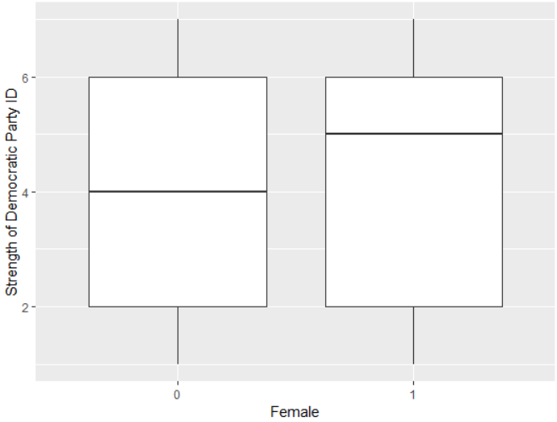
(1) EDA, Part 2

Slide 9
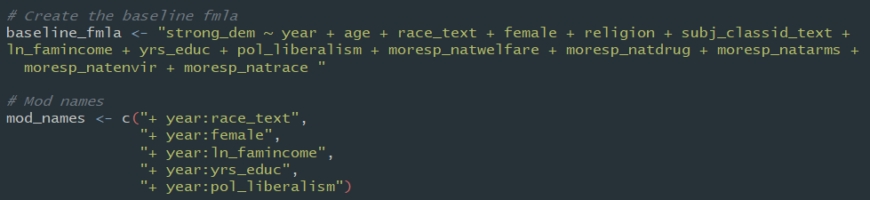
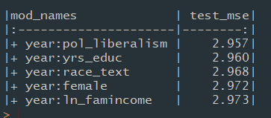
(2) Model Building, Part 1
Question:
Can I use the existing literature (theory, empirical findings) and the EDA to build a model that will outperform the models based on automated methods?

Slide 10
(2) Model Building, Part 2: Automated Methods
(A) I used k-fold CV (k = 10) to find the optimal tuning parameters (either lambda or M) for: Ridge, Lasso, PCR, and PLS
Then, to actually fit my candidate models, I ran each method using the optimal tuning parameters on the model-building set (25% of the full sample)
(B) Next, I also used the forward and backward variable selection methods to fit an optimal model for each method
Best subset selection was not used because it was too computationally demanding (it requires fitting and comparing 2^{p} models)

Slide 11
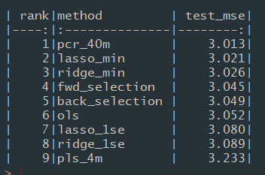
(3) Model Validation: Choosing the Final Model
In the 3rd step, I compared the candidate models by testing them using the validation set (25% of the full sample)
To clarify: the model-building set (a separate dataset) was used to fit each of the candidate models
Key takeaways:
(1) The forward selection method performed best (i.e., it generated the smallest test MSE), but the differences in test MSE among the candidate models is slight
(2) Given how small the differences are, they could have been due to chance alone.
So I decided to move forward with my OLS model, which includes an interaction effect between political liberalism and year

Slide 12
(4) Testing the final model
In the final step, I tested the best OLS model using a held-out test set.
The test MSE was ~3.005
Key takeaways:
(1) How well can the models predict a person’s party preferences?
Not that well: the SD of the DV is ~2.0 and the RMSE of the best model is ~1.7
SD: average deviation of the actual Y from its mean value
RMSE: average difference between actual and predicted Y values
This is also evidenced by the relatively low adjusted R-squared: ~.23
(2) Which predictors matter most?
Let’s look to the next slide

Slide 13
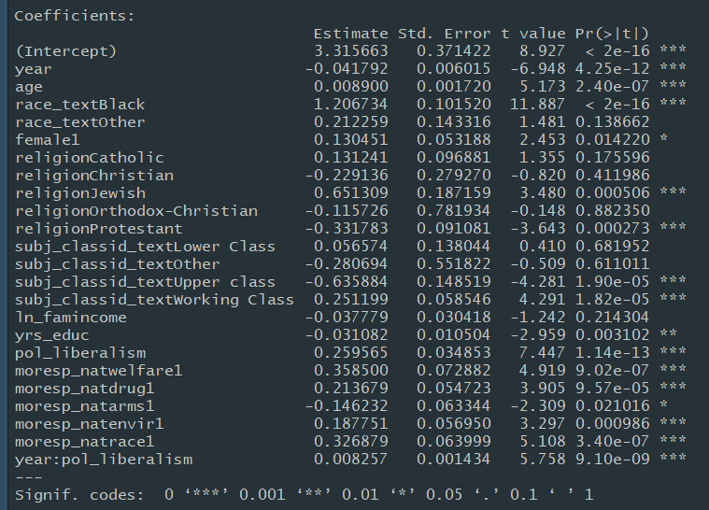
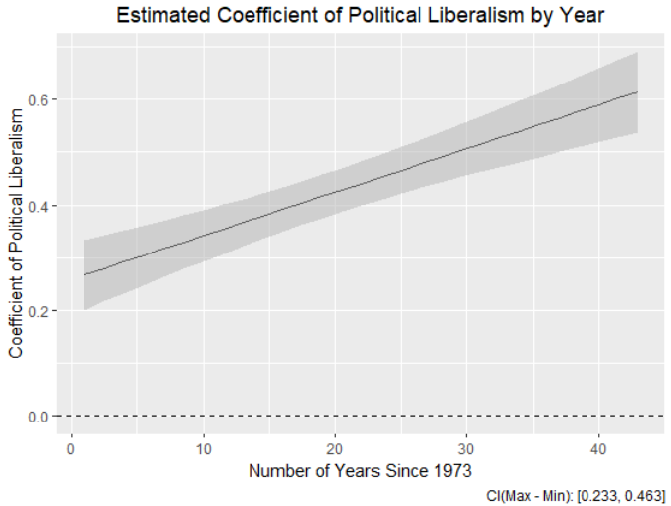
Substantive Findings: Predictors, P-values, Coefficient sizes
The strength of the link between ideology and party ID (or polarization) has increased over time
The Best OLS Model

Slide 14
Questions, comments, and suggestions are welcome
Thanks!

